Slide 1


01
Houseprice Prediction
20BCP046 Shreya Panengaden

Slide 2


INTRODUCTION
02
House price prediction is a critical task in the real estate industry and has garnered considerable attention in the field of machine learning and data science. The prediction of real estate property prices is of paramount importance in the housing market, as it empowers buyers, sellers, and investors with valuable insights for informed decision-making.
Predicting house prices is a complex task influenced by various factors such as location, property characteristics, economic conditions, and more. This complexity makes it a fascinating problem for data scientists and machine learning practitioners.
The primary objective is to provide a reliable tool for estimating property values, thereby aiding stakeholders in making well-informed choices. Today, we will explore how data-driven approaches and machine learning models can be used to tackle the challenge of house price prediction.

Slide 3


03
DATASET
Boston housing dataset UCI ML repository
The dataset was sourced from the StatLib library, which is maintained at Carnegie Mellon University created by Harrison, D. and Rubinfeld, D.L. for their research on "Hedonic prices and the demand for clean air," published in the Journal of Environmental Economics & Management in 1978. The dataset was documented on July 7, 1993.
Attributes: There are 13 continuous attributes, along with one binary-valued attribute, for a total of 14 attributes. The "MEDV" attribute serves as the class attribute.
The dataset contains no missing attribute values.

Slide 4


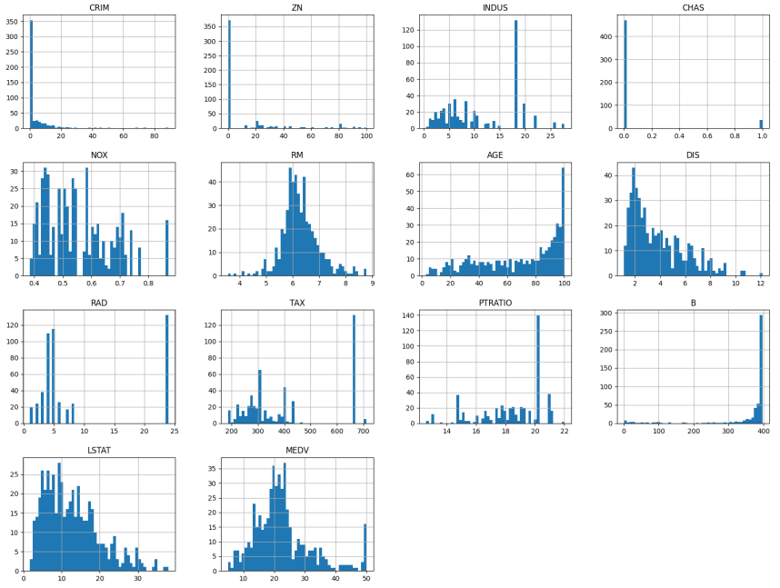
DATA VISUALIZATION
04

Slide 5
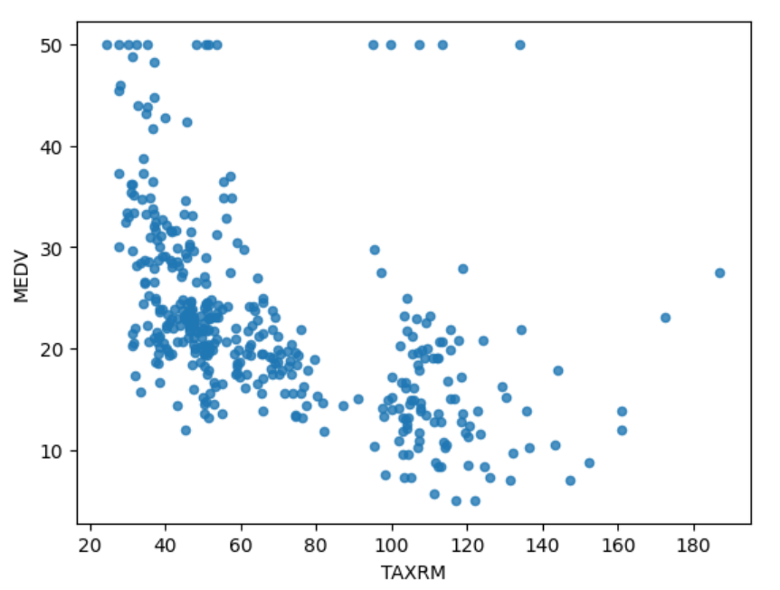
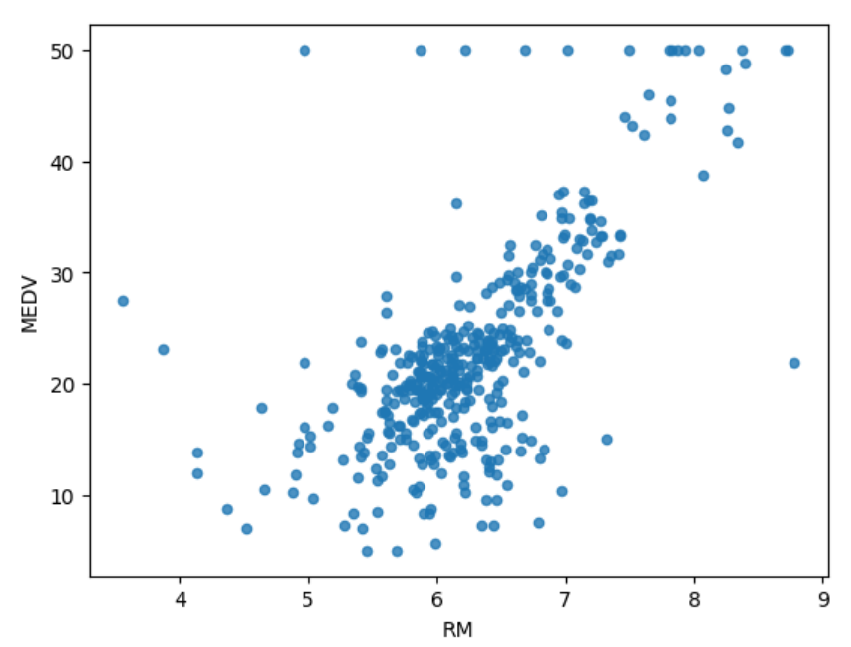
CORRELATIONS
05

Slide 6
06
Check for missing values and handle them through imputation with median.
We also perform standardization.
Create a pileine for above operations.
Split the data into training and test data.
Also, stratified split on CHAS column
DATA PREPROCESSING

Slide 7
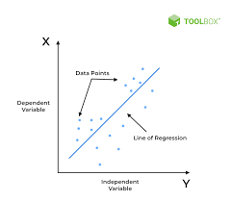
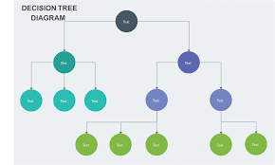
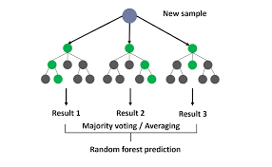
MODEL
07
Linear Regression
Decision Tree
RandomForest
Model the relationship between a dependent variable (target) and one or more independent variables (features) by fitting a linear equation.
Root Mean Square Error: 4.94
Create a tree-like model that partitions the data into subsets, making decisions based on feature values to predict the target variable.
Root Mean Square Error: 2.81
A Random Forest consists of a collection of decision trees, each trained on a random subset of the data and features. Predictions are made by aggregating the predictions of individual trees.
Root Mean Square Error: 1.38

Slide 8

RESULT AND DISCUSSION
Random Forest Regression achieved the lowest root mean square error (RMSE) among the tested models, making it our choice for testing. On testing the model on test data, RMSE obtained is 2.81
This model can serve as a valuable tool for buyers, sellers, and investors, offering informed insights for decision-making in the housing sector.

Slide 9

THANK YOU

